Slide 1


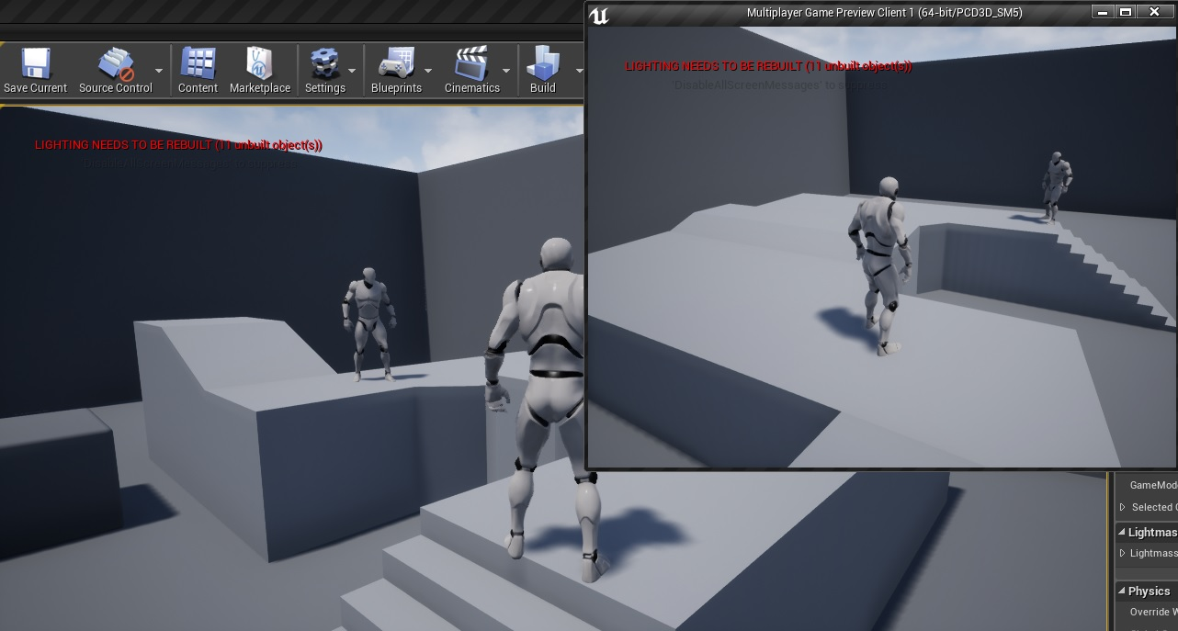
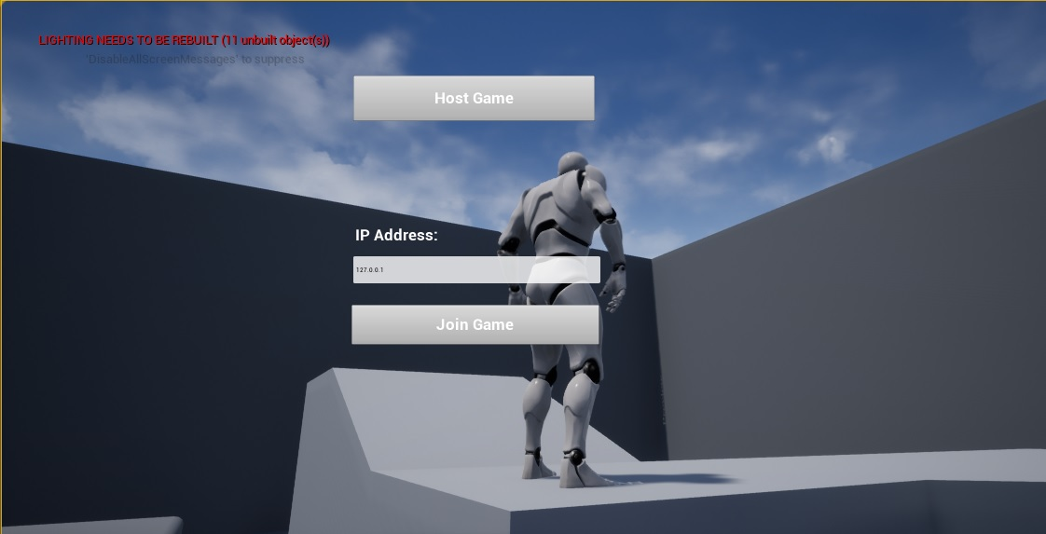
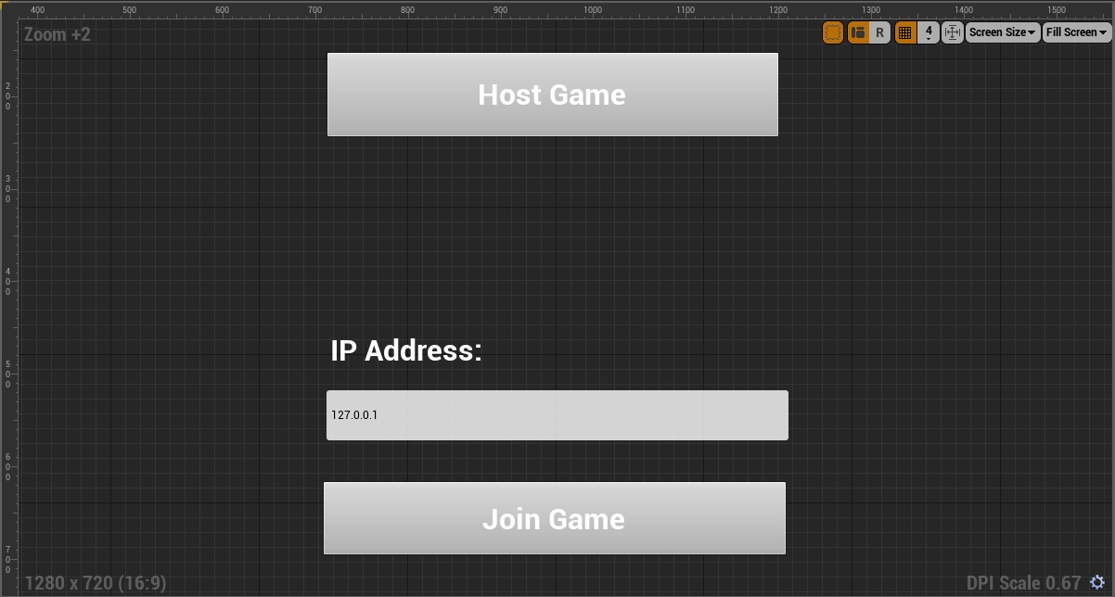
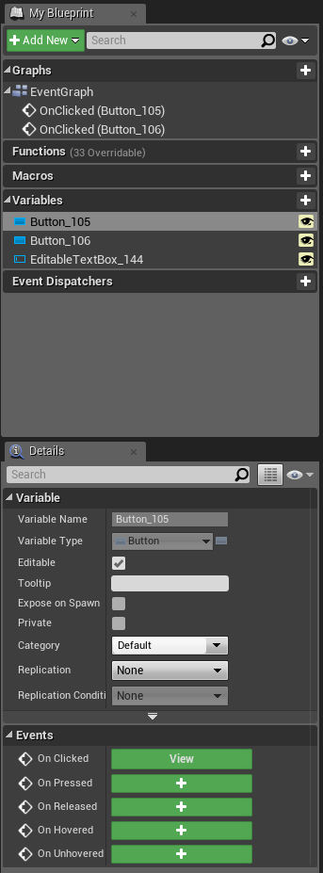
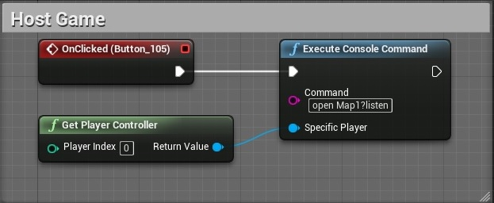
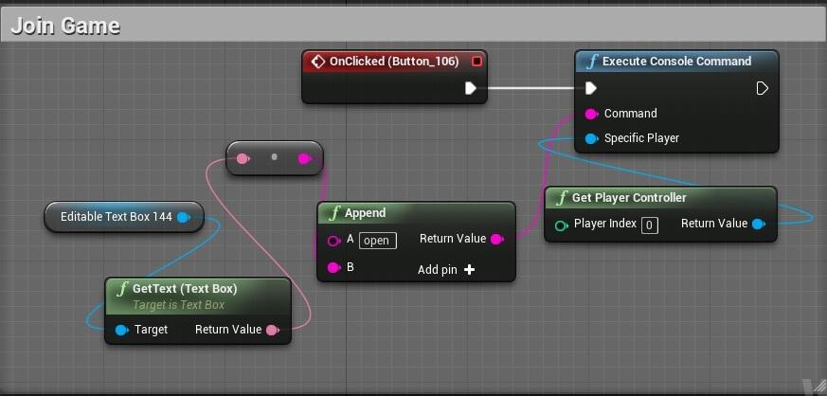
VIP Junior, Spring 2017
3D CodeBlocks for Multi-touch midAir-and Motion for Virtual and Augmented Reality (TAM)
Networking in VR Codeblocks
Student: Taufiq Islam, Florida International University
Mentor: Dr. Francisco R. Ortega, OpenHID Lab, Forida International University
Instructor: Dr. Mohsen Taheri, Dr. Francisco R. Ortega, Florida International University
Problem
The 3D CodeBlocks application lacked multiplayer aspects and did not have networking functionality, so two different players could not collaborate in the same CodeBlocks game.
Solution
Take advantage of a lot of the built-in networking functionality already present in Unreal Engine 4, and implement client-server functionality through event graphing to our 3D CodeBlocks application to allow for collaboration between two different users.
Current System
There was no current, or previous Unreal Engine networking code for 3D CodeBlocks, so this functionality would be the first release to build upon.
Screenshots
.
Requirements
The networking aspect of our Vive application should allow users playing to:
1. Create and host a LAN server which players can join using an IP address.
2. Join a LAN server that has been created by another player.
3. Have client and server communicate with eachother live to accommodate multiplayer.
Blueprint Variables
Implementation
Host:
Join:
Verification
Testing the networking portion of our project consisted of a manual-based user interface testing approach to see if the menu buttons were functioning and made the appropriate method calls.
For example, clicking on “host a server” to see if the player would be transferred a new room and clicking on “join a game” and entering an IP address to see if a player could join.
Summary
In summary, multiplayer functionality in 3D CodeBlocks allows for a more immersive and interactive experience between two users who are learning the basics of programming through the simplified visual interface provided through CodeBlocks.
System Design
The multiplayer networking interface for this project was developed using Unreal Engine 4’s client-server model through event graphing.
Acknowledgement
The material presented in this poster is based upon the work supported by Dr. Mohsen Taheri and I am thankful for the help that I received from my group member Fernando De Zayas.
Notes:
‹#›

